Slide 1
Ring counter
D.SAI CHAND REDDY
22R01A0575
CSE-B

Slide 2
Introduction to counters:-
A binary counter uses 2 or more single clocked flip-flops depending on the number of bits required.
There are 2 types of counters Synchronous and Asynchronous.
A asynchronous counter uses a single clock at the first stage .
But in a synchronous counter all flip-flops are clocked together with a common clock pulse.

Slide 3
Ring counter:-
ring counter is a typical application of the Shift register.
The ring counter is almost the same as the shift counter.
The only change is that the output of the last flip-flop is connected to the input of the first flip-flop in the case of the ring counter but in the case of the shift register it is taken as output. Except for this, all the other things are the same.
A ring counter is a type of counter composed of flip-flops connected into a shift register, with the output of the last flip-flop fed to the input of the first, making a "circular" or "ring" structure

Slide 4
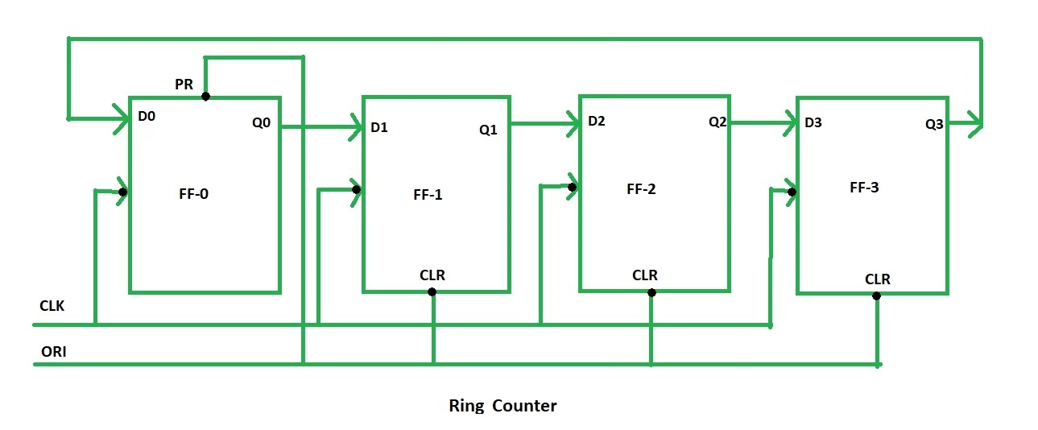
Circuit diagram for four bits ring counter:-

Slide 5
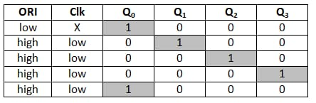
Working:-
The ORI input is passed to the PR input of the first flip flop, i.e., FF-0, and it is also passed to the clear input of the remaining three flip flops, i.e., FF-1, FF-2, and FF-3. The pre-set input set to 0 for the first flip flop. So, the output of the first flip flop is one, and the outputs of the remaining flip flops are 0. The output of the first flip flop is used to form the ring in the ring counter and referred to as Pre-set 1.

Slide 6
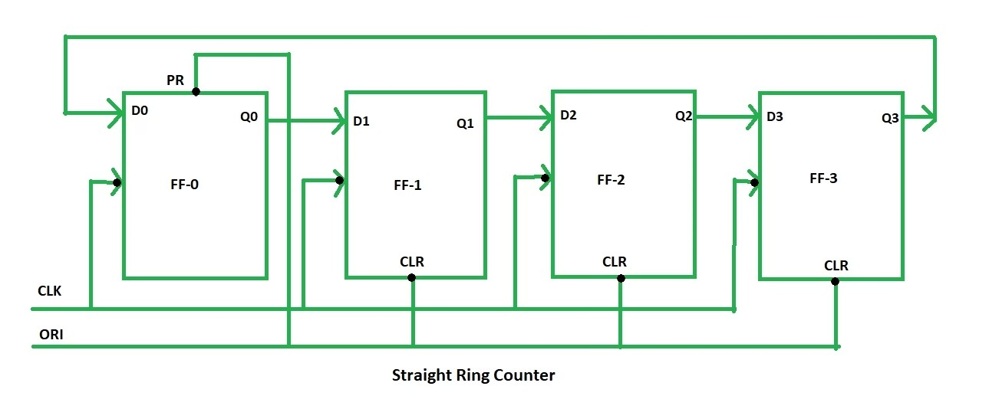
Types of ring counters:- There are two types of Ring Counter:
Straight Ring Counter:
It is also known as One hot Counter. In this counter, the output of the last flip-flop is connected to the input of the first flip-flop. The main point of this Counter is that it circulates a single one or zero bit around the ring.

Slide 7
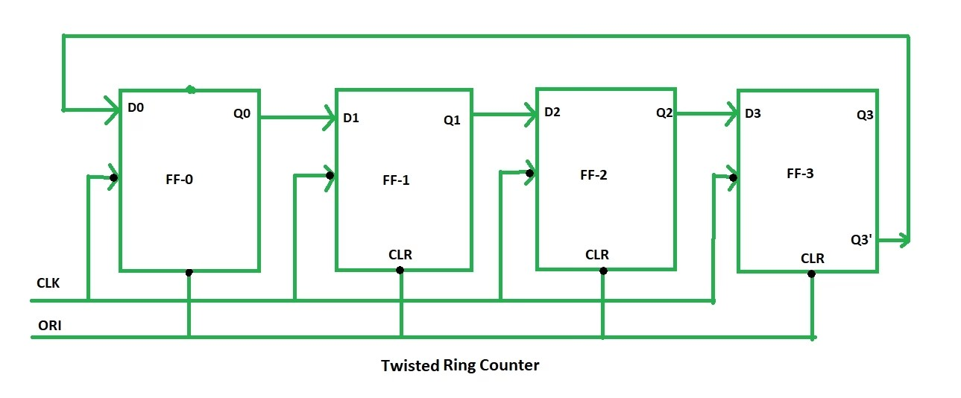
Twisted Ring Counter:-
It is also known as a switch-tail ring counter, walking ring counter, or Johnson counter. It connects the complement of the output of the last shift register to the input of the first register and circulates a stream of ones followed by zeros around the ring.

Slide 8
Thank you

